Slide 1
Ping Pong Machine
Gurwarris singh sohi

Slide 2
Introduction
Objective: Make a cost effective ping pong machine.
Problem: No speed modulation and use more hardware to launch.
Explanation: The original machine uses a pair of motors set a constant speed and servo /or stepper motors to aim the balls.
Solution: Use PWM controlled DC motors, to launch ping pong balls at variable speeds and angles.
Explanation: My design uses PWM to alter launch speed at any time. It also allows me to modulate the speed of either motor so, a difference in the speed of the motors allow me to launch balls at variable angles, without using servo /or stepper motors.

Slide 3
Budget
Raspberry 4 Model B (extra cost) + CDN$ 152.54
HDMI to VGA adapter (extra cost) + CDN$ 22.59
DC motors (extra cost) + CDN$ 12.73
TB6612FNG (extra cost) + CDN$ 17.74
Shipping/Delivery (no extra cost or already included) + CDN$ 0.00

Slide 4
Schedule
Breadboard Design
Setback: I made a mistake in using a port, and while testing, I thought my code had a bug.
PCB Design
Setback: The earlier setback costed me my first PCB. I had to design, print and solder a whole new PCB, which led to a schedule setback.
Enclosure
Setback: My first enclosure was designed just to hold Raspberry Pi, but the mounted driver PCB didn’t fit in. Had to create a new one.

Slide 5
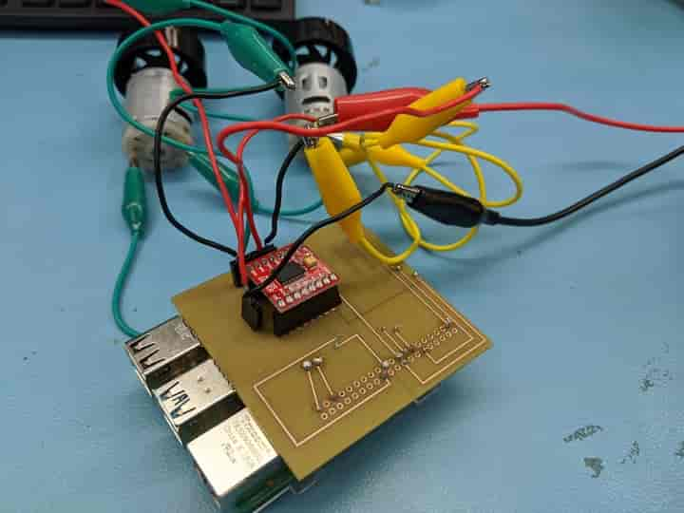
Prototype Hooked Up

Slide 6
Previous Course Knowledge
TECH 103 Digital Fundamentals - Logic Design
TECH 101 Electric Circuits + TECH 150 Electronic Devices and Circuits - Lab equipment and safety precautions
TECH 150 Electronic Devices and Circuits – Soldering
CENG215 Digital and Interface Systems – Controlling a DC motor with PWM
CENG252 Embedded Systems - Programming on Raspberry Pi
https://learn.sparkfun.com/tutorials/tb6612fng-hookup-guide/all

Slide 7
Thank You

